Slide 1

Case interview
CMC Senior Data Engineer
June 2023
Notes:
Title slide
Front page
First page
Life-changing careers
P&O
People and organization

Slide 2
Purpose of this case
Two key parts of the Senior Data Engineer role are to:
Structure data into fit for use data models
Transform and load data
This exercise will be used as a foundation for a technical talk as part of your interview.
Parts of your solution may be brought up - the purpose of this is to enable a discussion.
There is no right or wrong way to solve any of these tasks.
You are free to use any language and/or modelling tools you want, your solutions can be presented as models, code, pseudo-code or with text.
Your answers to the exercise is used as a basis for discussion for us to dive into. You do not need to implement anything, as long as your solutions provide insight into your solution design that will do.
On slide 3 and 4, you will find the exercise and more information about the structure of the interview. If you have any questions, please contact Marc Tom Thorgersen at yrmt@novonordisk.com

Slide 3
Exercise
## Exercise 2: Create a database based on the data
In the Data folder you will find several .CSV files that lay the foundation for these tasks.
Based on these files, we would like you to design a data model, there is no need to implement the database itself, the outcome of this should be a data model that can be implemented as a database.
Consider how you might want to structure tables to satisfy future usage of the data.
Keep in mind, that there is no particular use case you need to achieve, the data may be useful to several stakeholders in different ways.
For the solution to this exercise please include table & relationship considerations, this can be provided via ER-Diagram, UML Diagram or any similar representation of your data model.
## Exercise 2: Transform and load
With the data model in mind, consider how you would transform and load the data into a database that follows the data model design.
Consider both how you would load the initial data dump from CSV, but also how you might work with future dumps of data.
You can use different cloud services for reference or consider raw coding patterns for how to handle potential complication.
Also please highlight any potential issues you think a solution might need to be aware of in the implementation of such a solution.
Your solution to this does not have to be code, it can simply be a plan, pseudo-like code, architectural considerations etc.

Slide 4
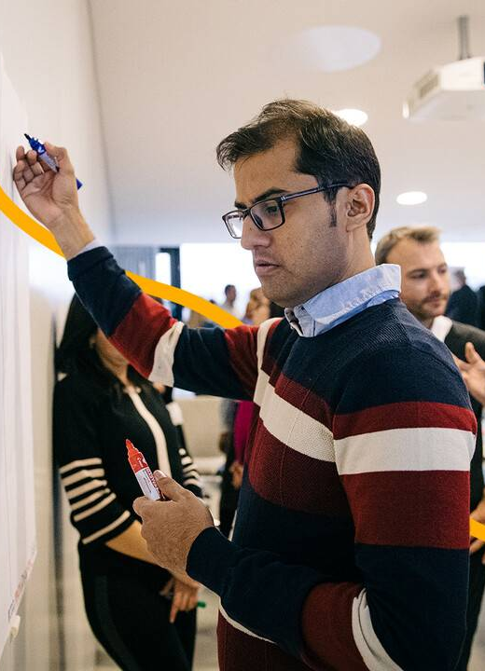
Interview structure
* Short introduction of the people in the room
* Short introduction of CMC and the department CMC Digitalisation
* Short introduction of you
There is no need to go through your CV as we have read it in details already
* Brief presentation of your solution design and your reflections (10 minutes)
You may use selected diagrams, pseudocode and similar elements used as part of your solution design presentation
* Q&A session
Novo Nordisk ask questions about your choices. Please note we may either ask these during your pitch or wait until afterwards.
Wrap up
Attendees
You will present the case to the following people from Novo Nordisk:
Camilla Büchler Seier Petersen, Sr. Manager, CMC Digitalisation
Marc Tom Thorgersen , Data Engineer, CMC Digitalisation
Notes:
Text slide
P&O
Life-changing careers
People and organization

Slide 5
Thank you
Notes:
Title slide
Front page
First page
Life-changing careers
P&O
People and organization

